Slide 1
Gyn path Seminar case - case #3 Ovarian germ cell and sex cord tumors
Rafael Bispo Paschoalini - M.D., MSc
Rede D’Or São Paulo | Instituto do Câncer de São Paulo - ICESP

Slide 2
Disclosure of Relevant Financial Relationships
I have no conflict of interest to disclose
RDC Nº 96/08 da ANVISA

Slide 3
Clinical History
Female, 34 years-old with a solid lesion in the right ovary, 5.3 x 4.7 cm and no adipose content. Suspicion: neoplastic tumor
No gastrointestinal complaints, using oral contraceptives and normal menstruation
No oncological history

Slide 4
Exams
CEA 0.6 AFP <1.3
CA-125 10.0 Androstenedione 0.76
CA19-9 6.7 Stradiol 42.0
Cortisol 20.0 (upper limit) DHEA 1.54
LDH 139.0 Sulfate-DHEA 76.83
PET-CT: Glycolytic metabolism in solid mass, no locoregional alterations (SUVmax 3,9)
US: Nodular and solid mass R.O. with Doppler flux. Little effusion on abdominal cavity
MRI: Solid mass, suspicious primary or secondary involvement: Call for investigation

Slide 5
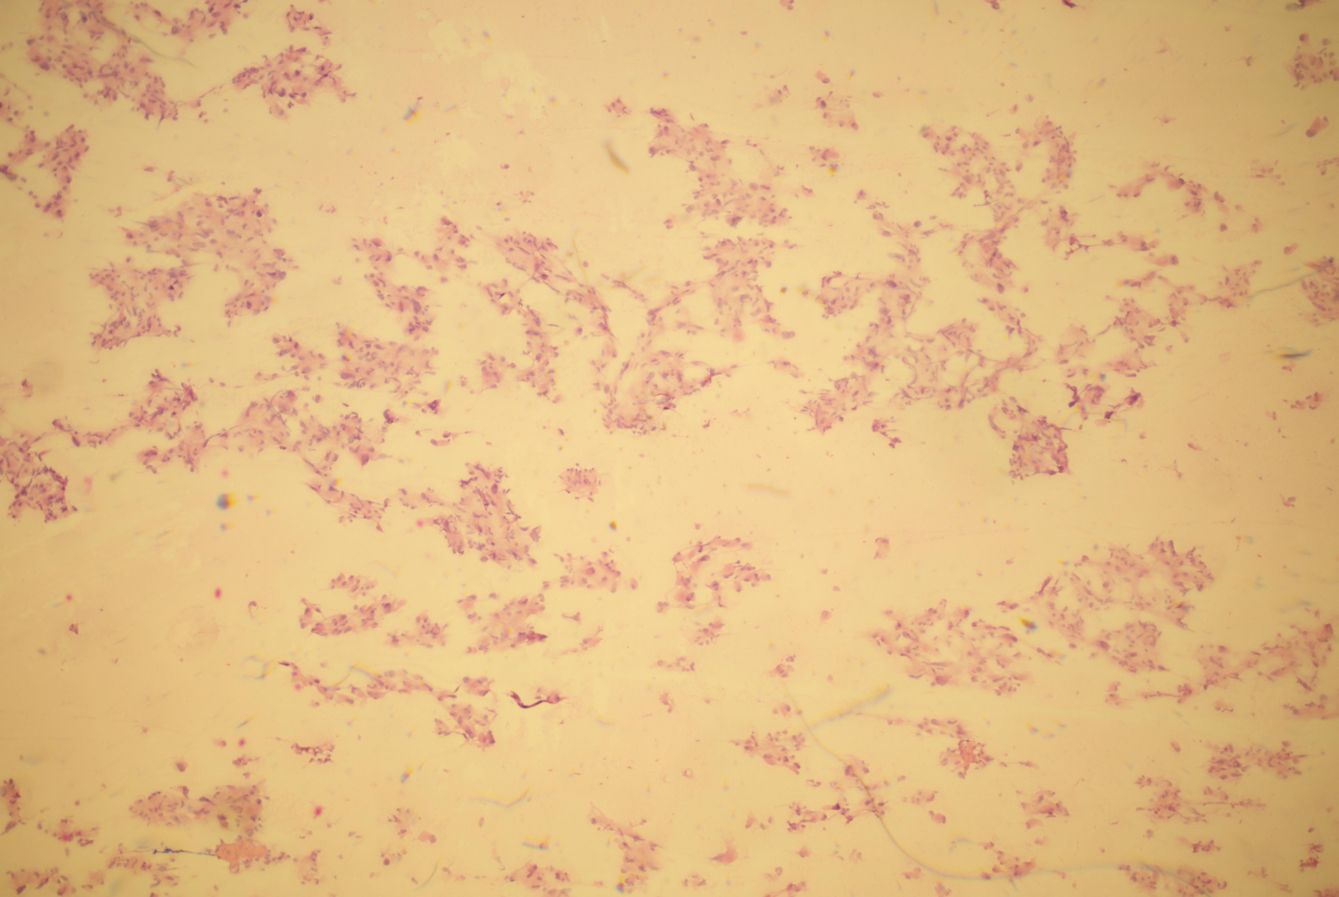
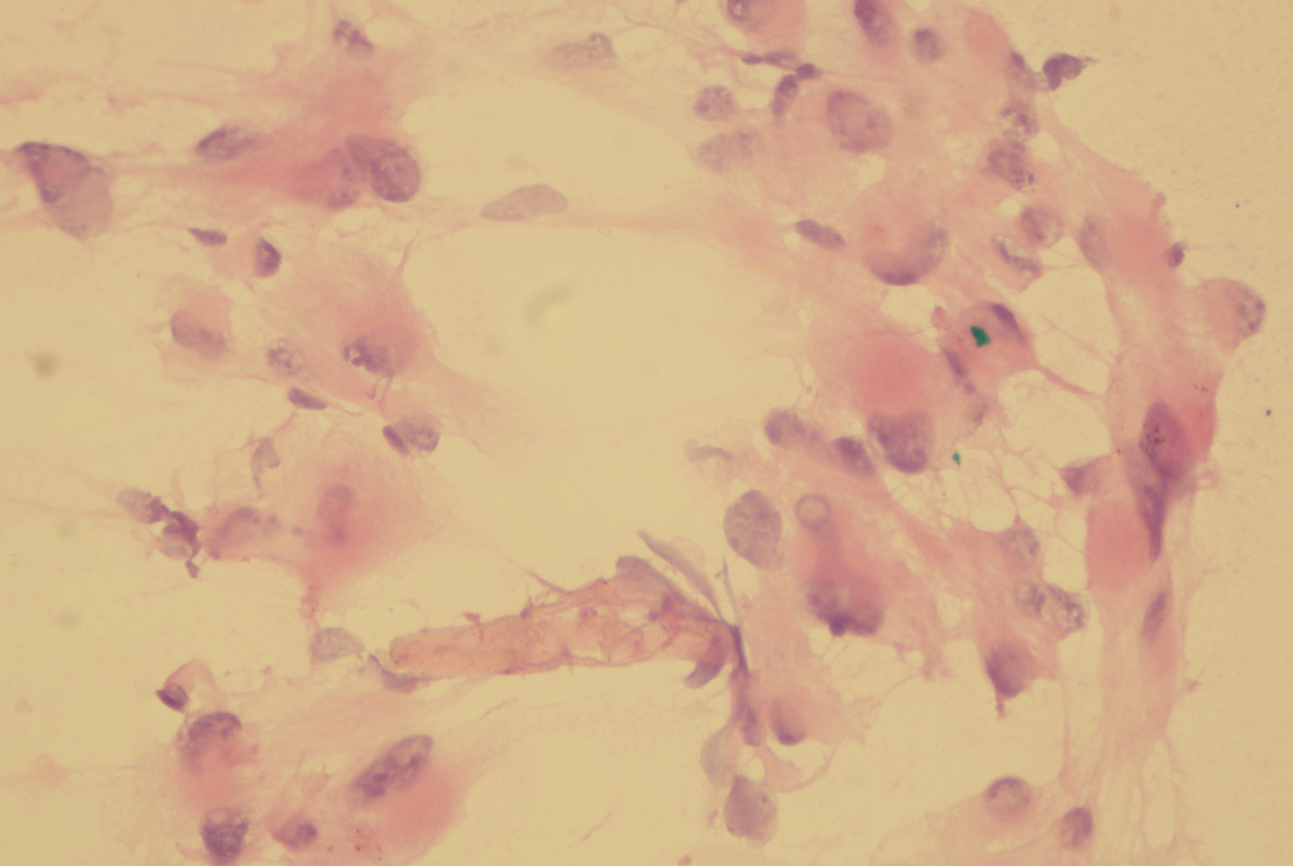
Frozen Section
Laparoscopic right salpingo-oophorectomy with excision of peritoneal lesions (Omentum, vaginal septum and uterine serosa)

Slide 6
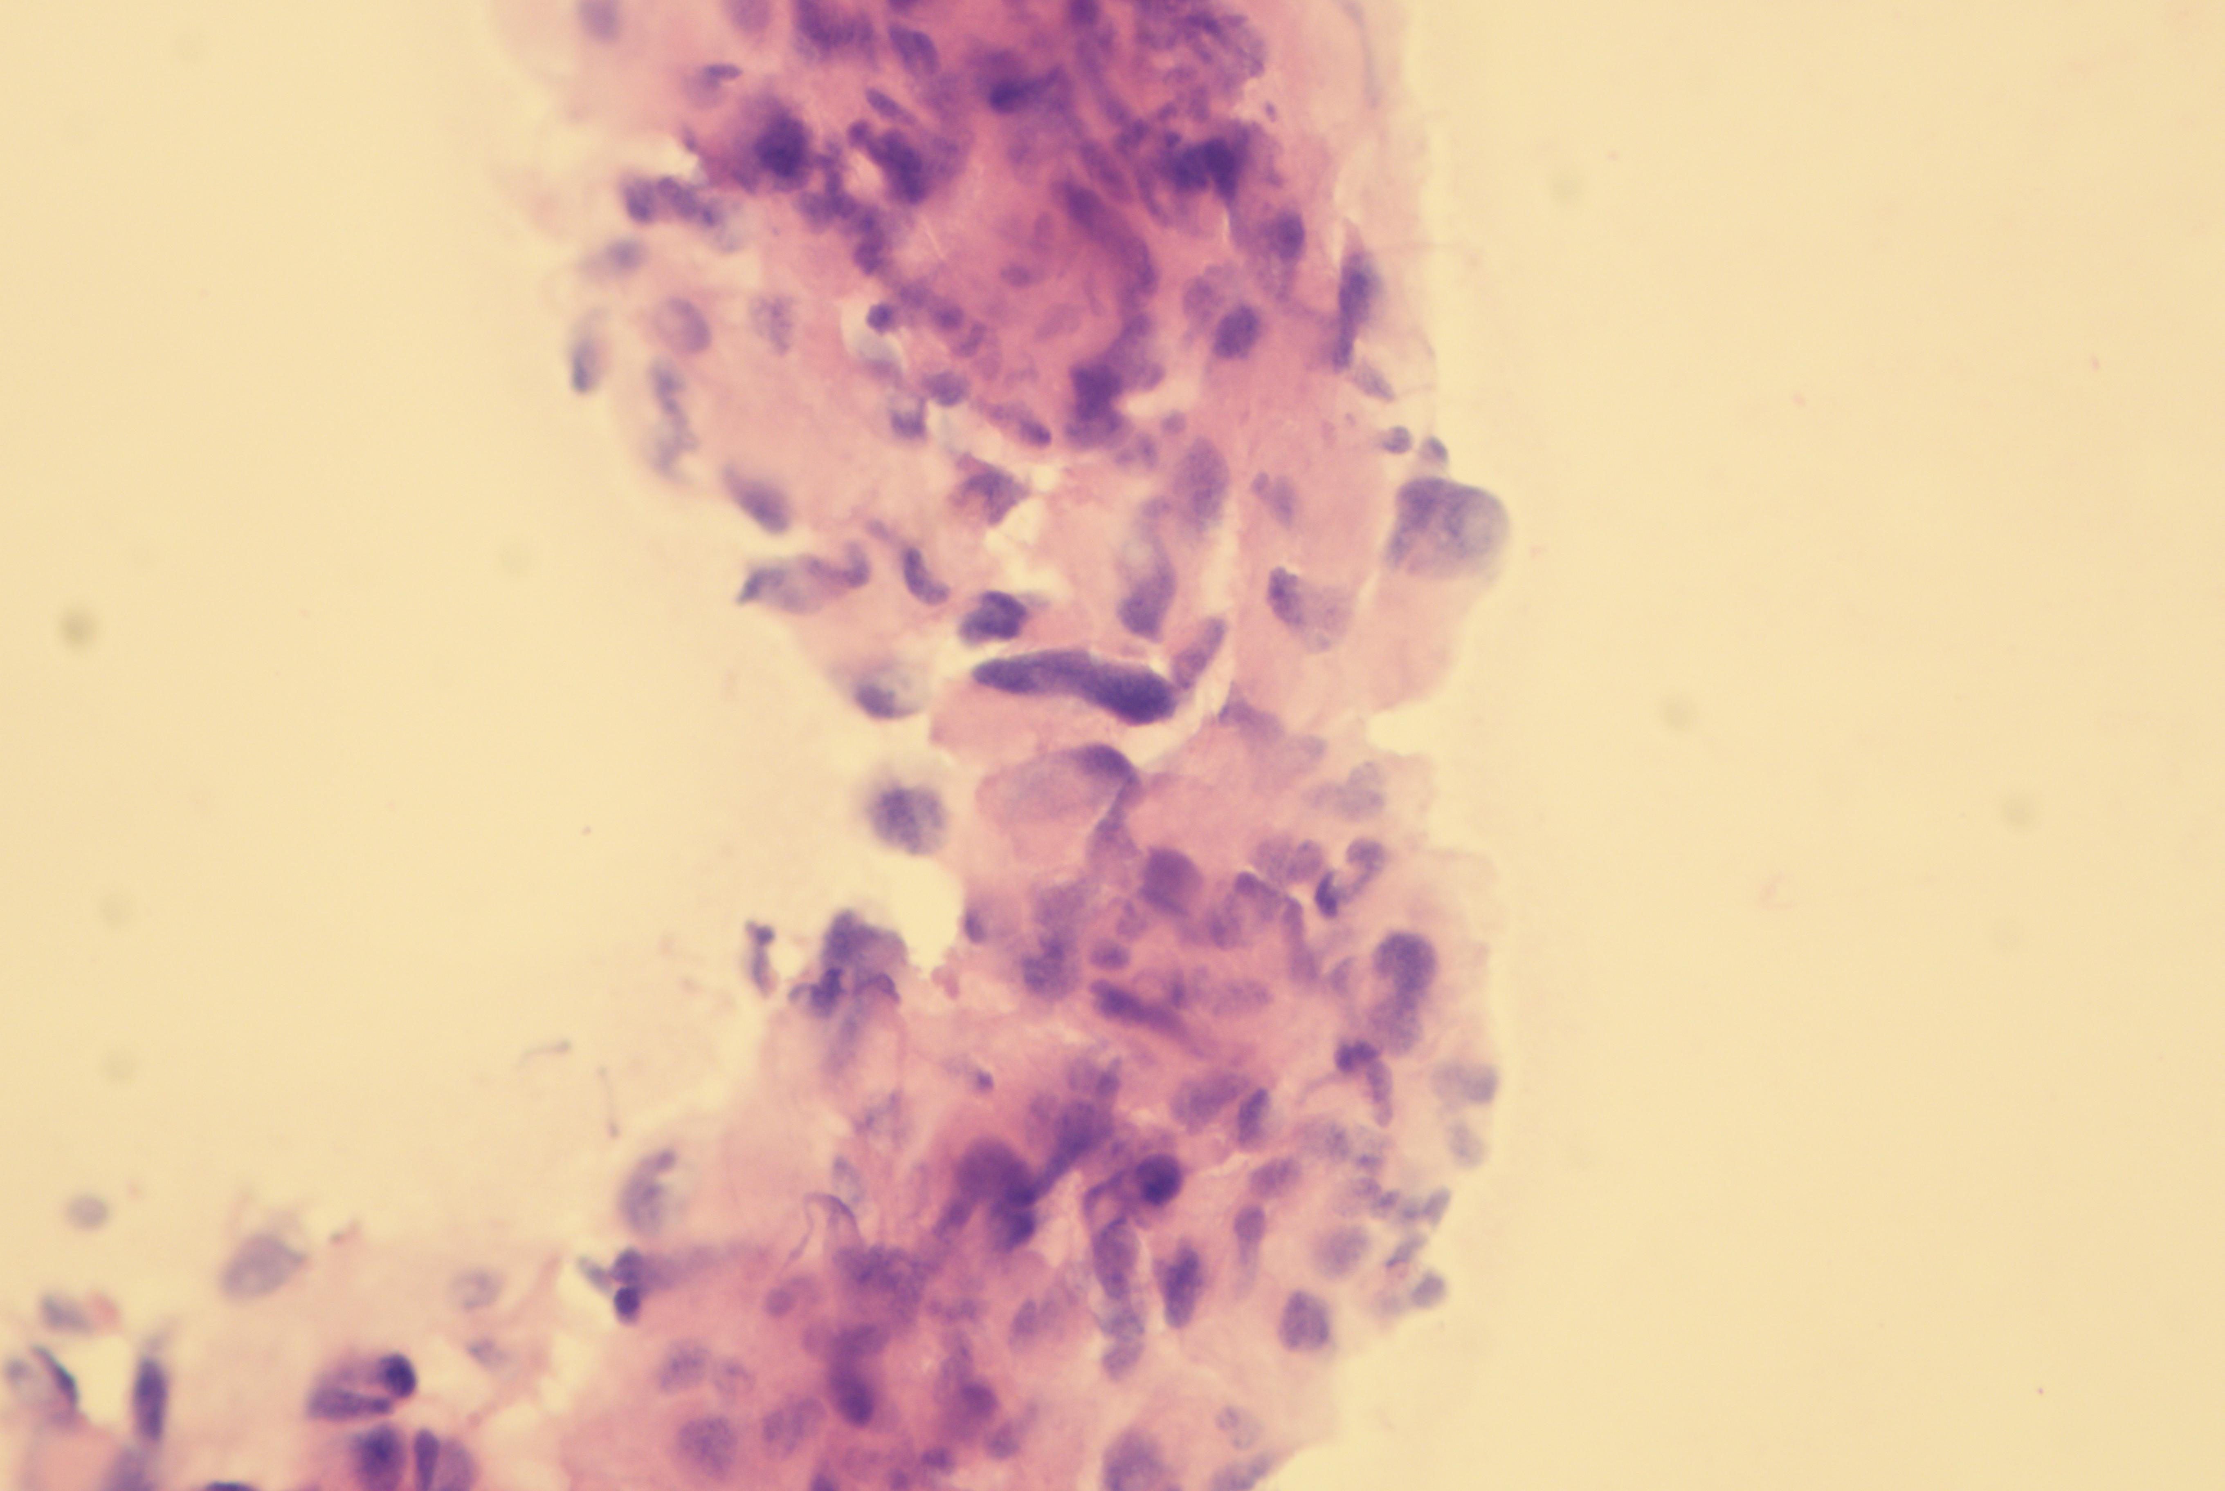
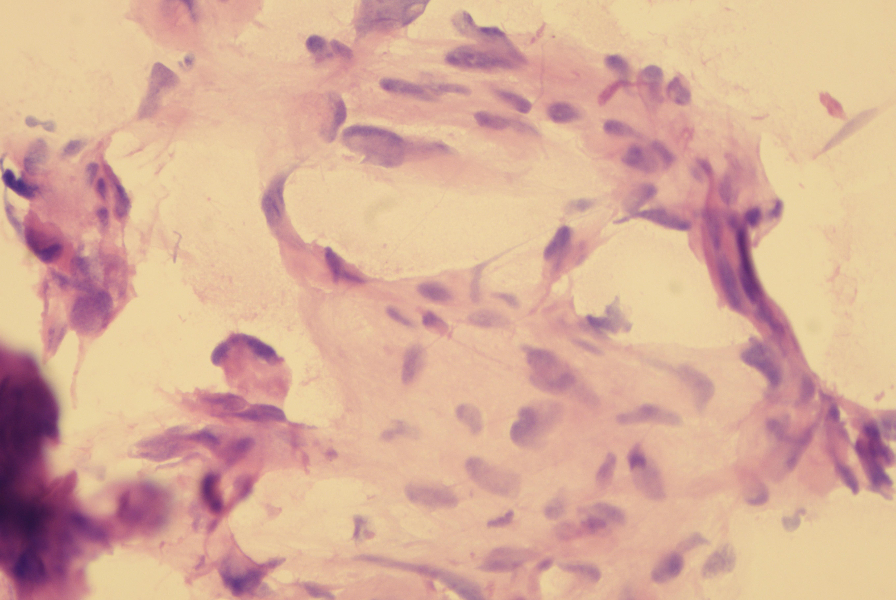
Frozen Section
Right ovary: Neoplasia with sex cord/ stromal differentiation with luteinization and atypia.
Note: The specimen was received with ruptured capsule

Slide 7
Macroscopy
Right adnex: Tumor with partial ruptured capsule with gray surface and haemorrhagic foci measuring 4.0 x 3.5 x 3.0 cm
The specimen was partially submitted to examination
(8 fragments in 6 paraffin blocks - 2 fragments/cm)

Slide 14
HYPOTHESIS

Slide 15
Differential Diagnosis
Pregnancy luteoma
Leydig cell tumor
Luteinized Granulosa cell tumor
Thecoma
Steroid cell tumor
Lipid-rich Sertoli cell tumor
Clear cell carcinoma (oxyphilic type)
Endometrioid carcinoma (oxyphilic)
Hepatoid yolk sac tumor
Hepatoid carcinomas
Endocrine tumors:
- Oxyphilic stuma ovarii
- Pituitary-type tumors
- Paragangliomas (pheochromocytoma)
Metastatic tumors:
- Renal cell carcinoma
- Adrenocortical carcinoma
- Hepatocellular carcinoma
- Melanoma

Slide 16
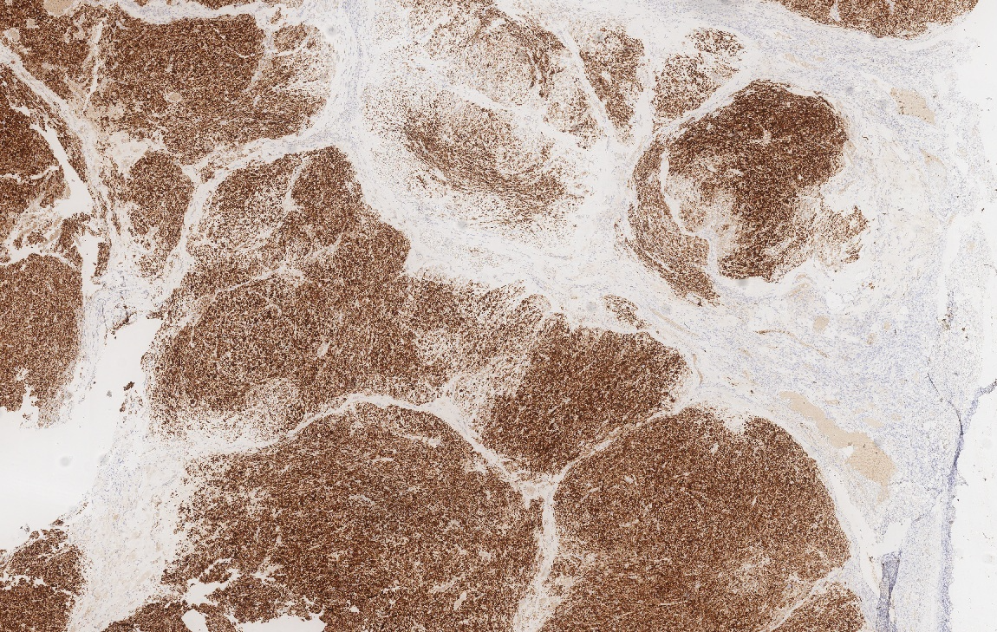
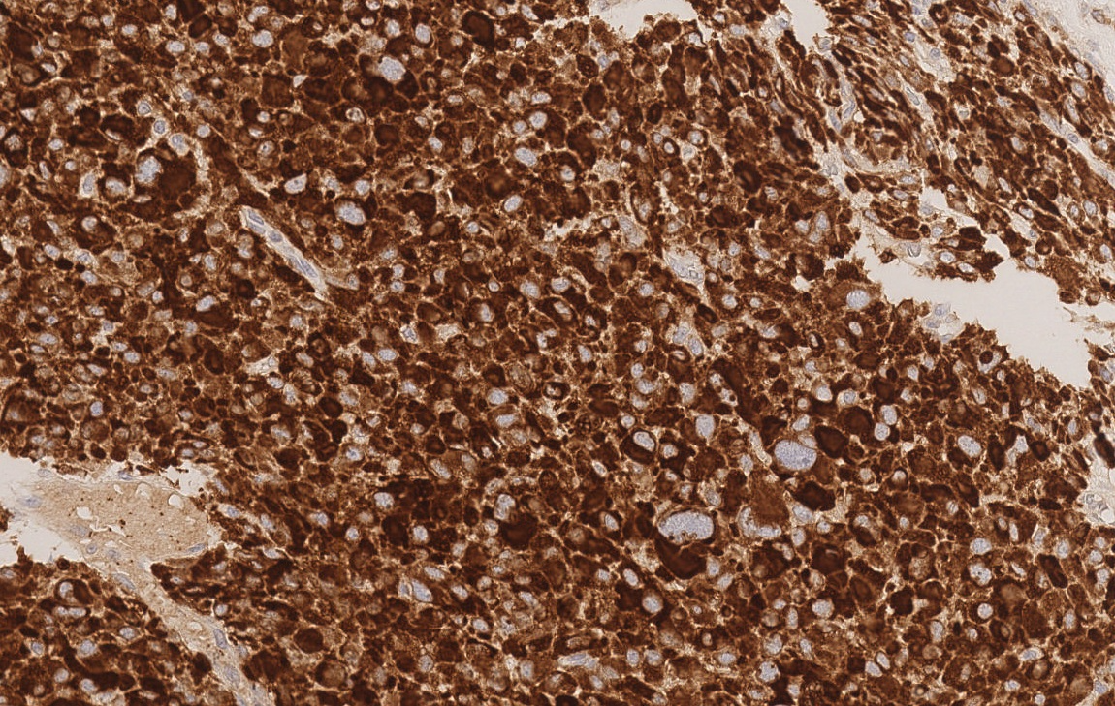
Inhibin

Slide 17
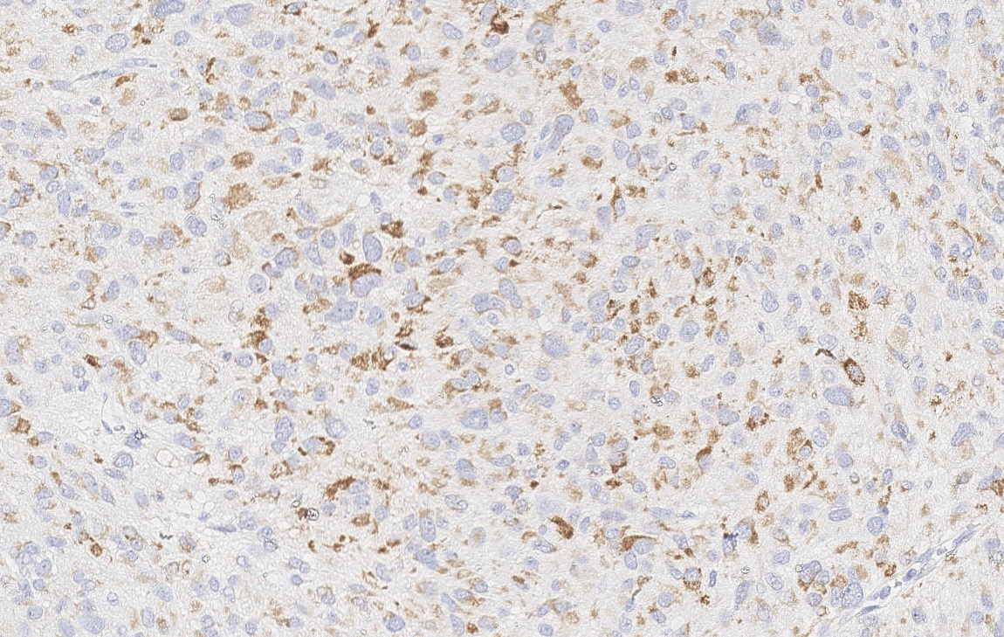
Melan-A

Slide 18
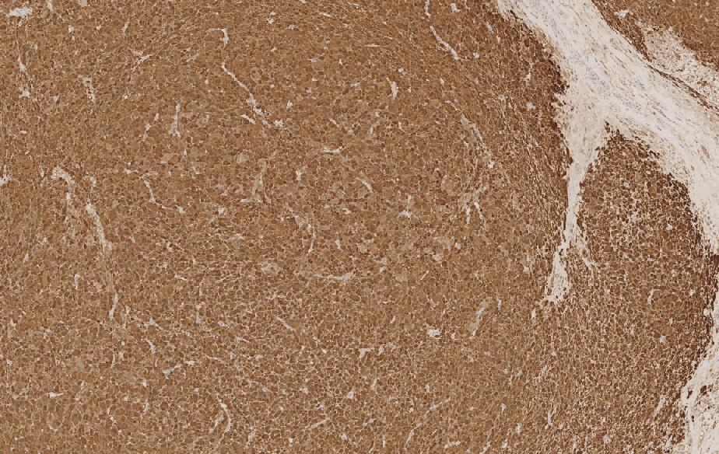
Other markers: Calretinin

Slide 19
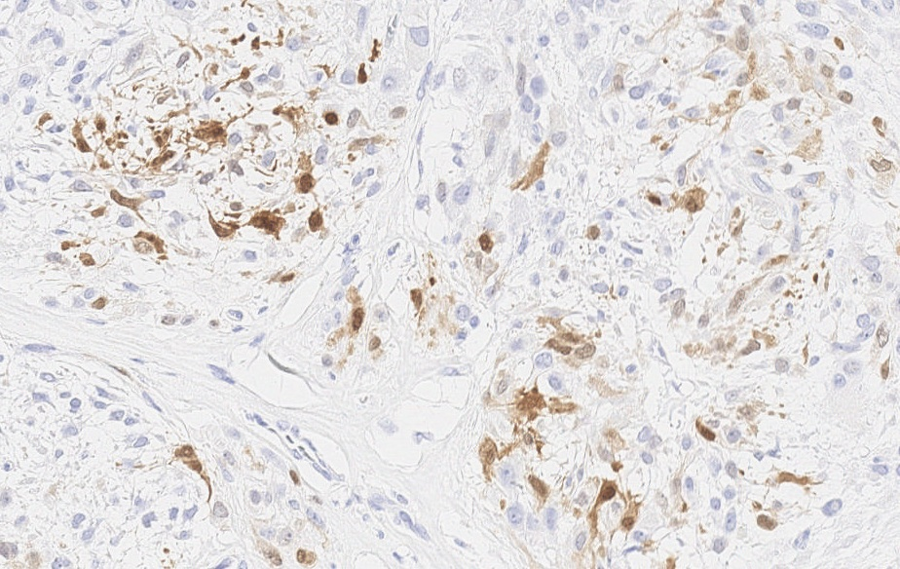
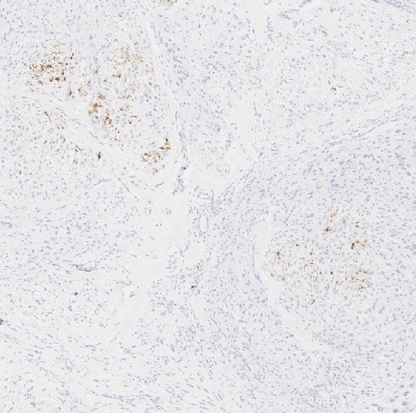
S100

Slide 20
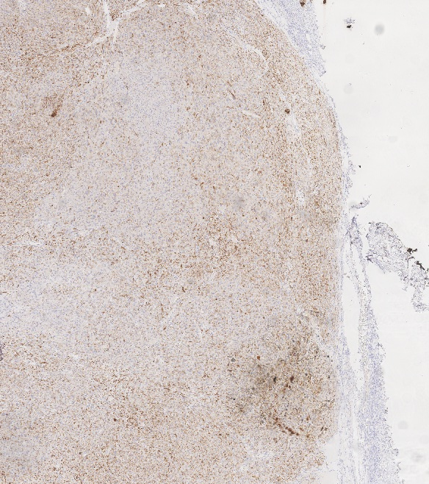
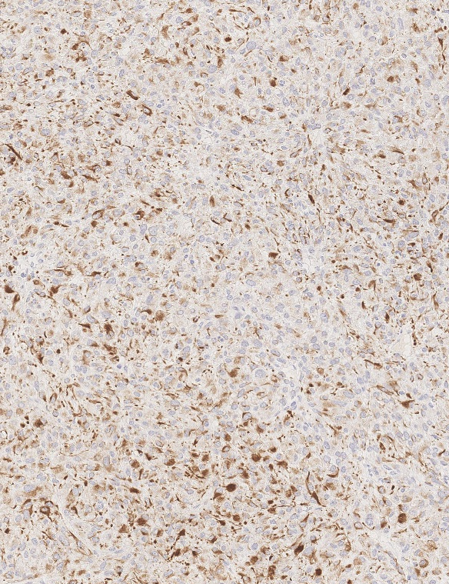
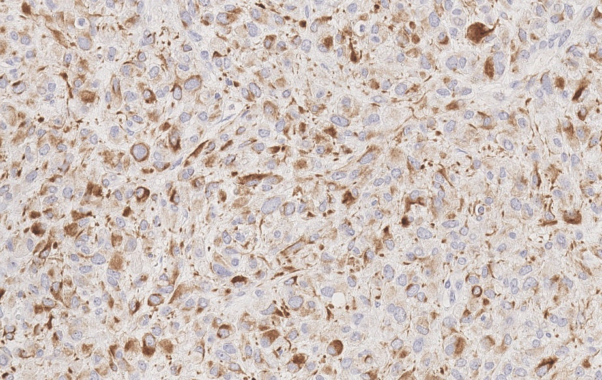
PanCK

Slide 21
Immuno Summary
Marker | Result
Inhibin | Positive, diffuse
Calretinin | Positive, diffuse
Melan-A | Positive, focal
Pancytokeratin | Positive, focal
S100 | Positive, focal
HMB45 | Negative
Desmin | Negative
Myogenin | Negative
MyoD1 | Negative

Slide 22
DIAGNOSIS

Slide 23
Pathology Report
Steroid Cell Tumor of the ovary (WHO, 2020)
Size: 4.0 x 3.5 x 3.0 cm / Location: right ovary
Capsule: previously ruptured
Atypia: present, severe
Mitotic count: 3 mitosis / 10 hpf (0.196mm²)
Necrosis: absent
Surface involvement: absent
Vascular invasion: present
TNM/AJCC (8th Ed): pT1a (FIGO IA)
* PS:
Peritoneal lesions (Omentum, vaginal septum and uterine serosa):
Endosalpingiosis foci and fibrosis

Slide 24
Clinical Outcome
The patient had no indication to adjuvant therapy
The presence of some aggressive findings on report calls to active surveillance with image exams

Slide 25
DIFFERENTIAL DIAGNOSIS

Slide 26
Malignant Melanoma
Metastatic spread to gynecological sites is rare, with the ovary being an exceptionally rare location
Positive for S100, HMB-45, and Melan-A
HMB45 is widely considered as the most specific melanocytic marker, although even it might be positive in occasional ovarian steroid cell tumors
Steroid cell tumors are usually not as mitotically active as a melanoma, and the incidence of teratomatous elements, spindle cells, and melanin pigment supports the diagnosis of melanoma, though steroid cell tumors may contain lipofuscin pigment
Sbitti Y, et al. Diagnostic challenge for ovarian malignant melanoma in premenopausal women: primary or metastatic? World J Surg Oncol. 2011 Jun 17;9:65.

Slide 27
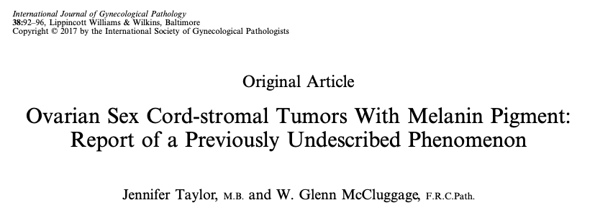
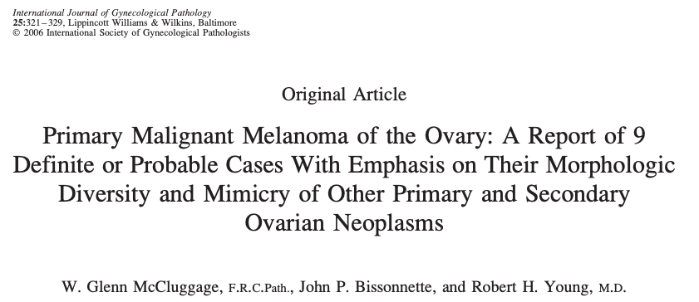
Ovarian sex cord-stromal neoplasms and steroid cell tumors are not uncommonly positive with some melanocytic markers, including S-100 and melan-A

Slide 28
Taylor J, McCluggage WG. Ovarian Sex Cord-stromal Tumors With Melanin Pigment: Report of a Previously Undescribed Phenomenon. Int J Gynecol Pathol. 2019;38(1):92-96.

Slide 29
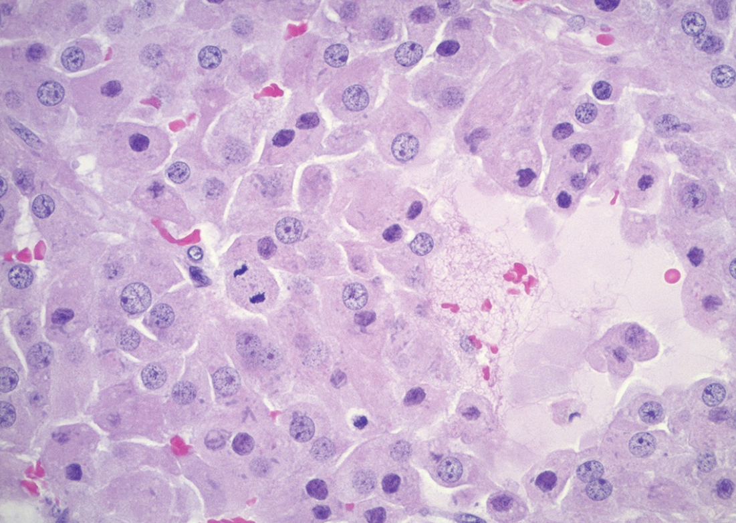
Pregnancy Luteoma
Occurs mainly among people around 30 years-old in the ovarian stroma (~ 6-7 cm)
Manifests late in pregnancy, bilateral in 30%
Androgenic manifestations (25%), incidental finding
Pseudoneoplastic condition (hCG-induced)
Displays small round nuclei with small nucleoli, evenly dispersed chromatin and abundant eosinophilic cytoplasm
Regresses spontaneously after pregnancy
WHO (2020)

Slide 30
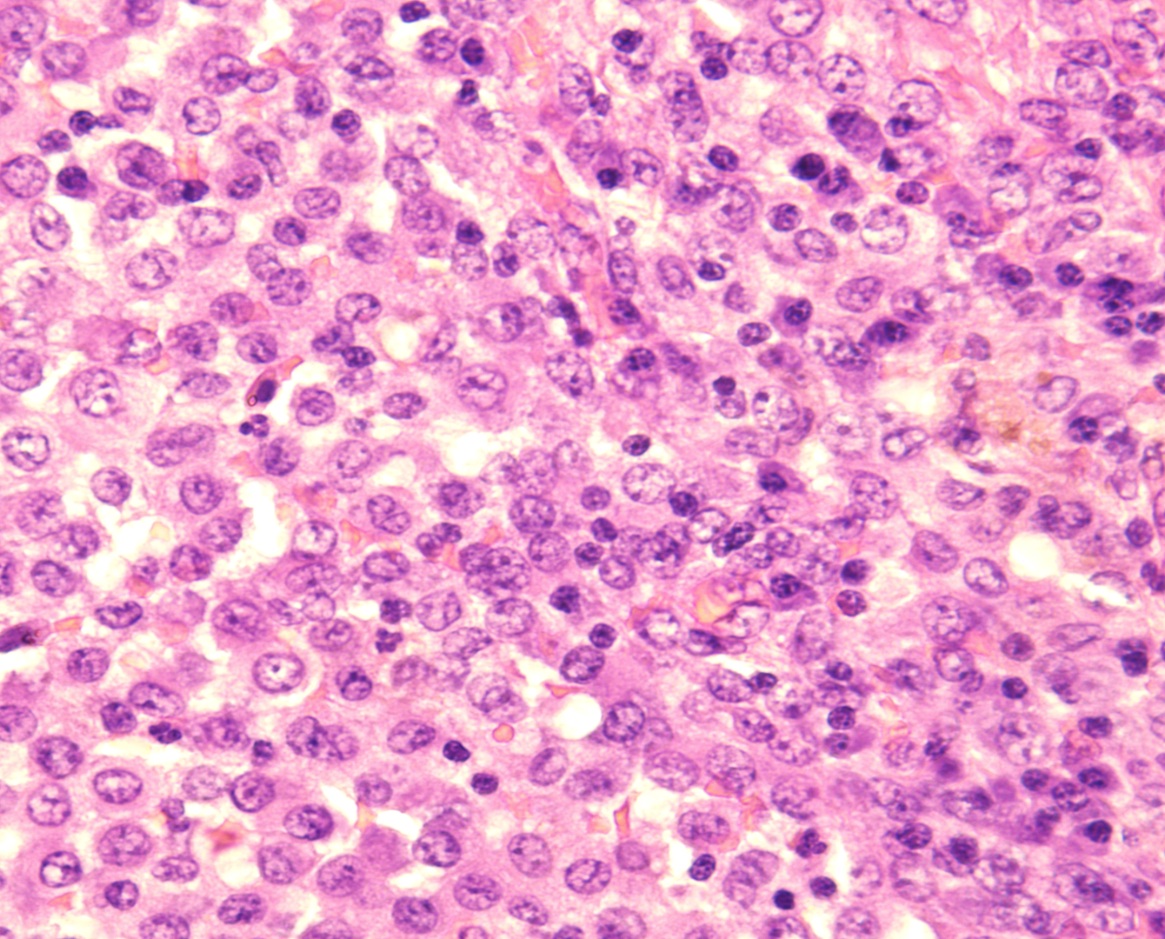
Leydig Cell Tumor
Postmenopausal women, almost always benign
May have androgenic or non-functional effects
Cut surface of the tumor may appear brownish with areas of hemorrhage
The cellular appearance is that of polygonal cell arrangements with large granular eosinophilic cytoplasm, conspicuous nucleoli and the presence of rod-shaped Reinke crystals
Inhibin, Calretinin, Melan-A may be positive

Slide 31
Granulosa Cell Tumor (Luteinized)
Mostly unilateral and restricted to the ovary; average size 10 to 12 cm
Encapsulated with smooth lobulated surface
Tumors with higher luteinization appear more yellow or orange
Characteristic cytologic nuclear grooves for the Adult-type and may have Call-Exner bodies
Luteinized adult type is rare (1%): plump cells with moderate to abundant eosinophilic cytoplasm, conspicuous nucleoli, no nuclear grooves, myxoid or edematous stroma
FOXL2 somatic mutation is highly sensitive and specific for diagnosis of Adult GCT
DD: Juvenile GCT has brisk mitotic activity, higher grade atypia, 90% FOXL2 negative

Slide 32
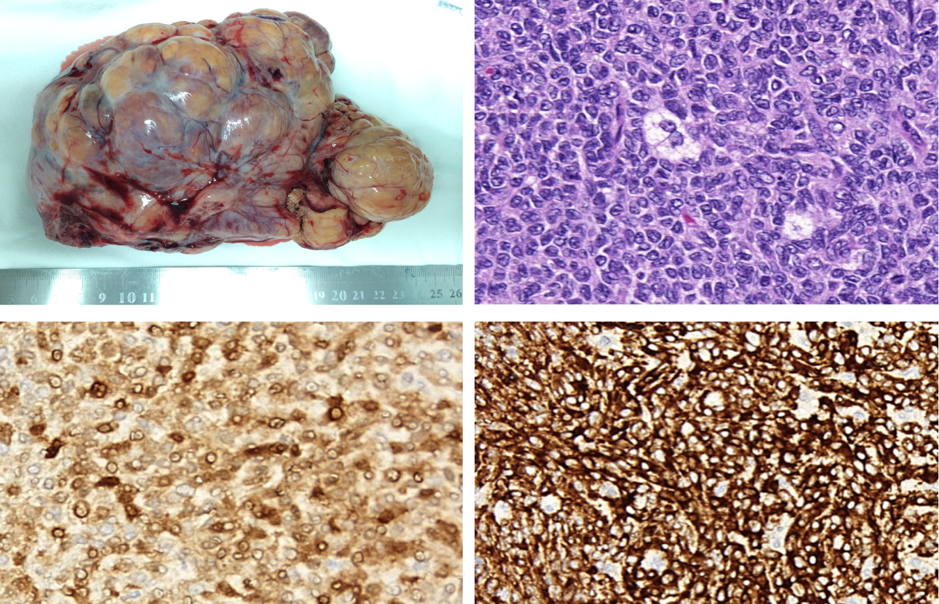
Caretinin
Inhibin

Slide 33
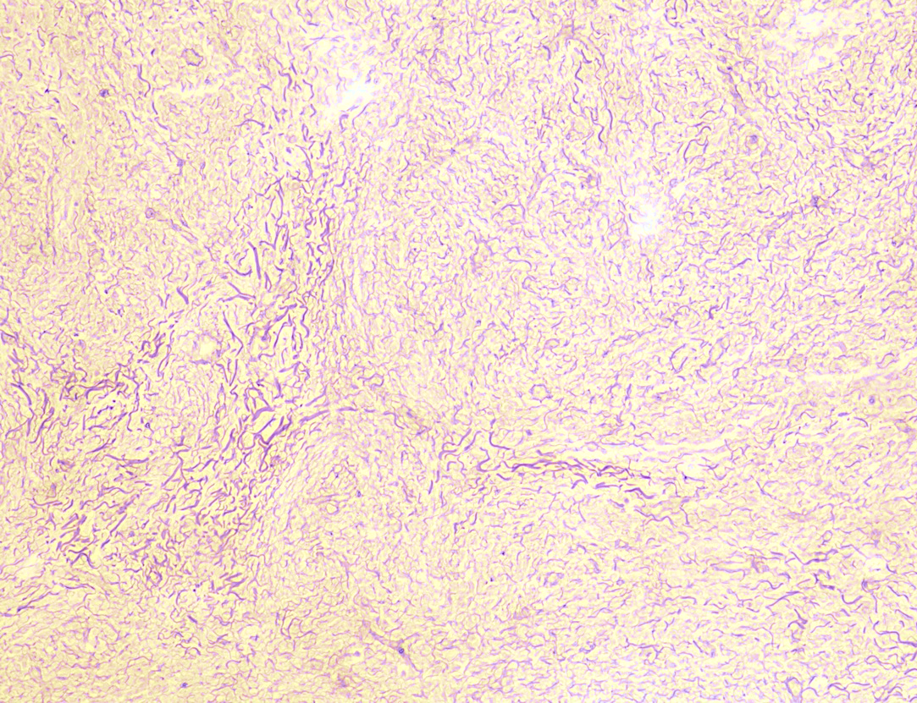
Reticulin

Slide 34
Thecoma
Benign behavior, often incidental, occurs during postmenopause
Associated estrogenic or androgenic manifestations
The tumor has a syncytial appearance of uniform cells with large, slightly grayish cytoplasm, regular nuclei and might have a 'luteinized' appearance
Calretinin, Inhibin, SF1 positive; *FOXL2 and WT1 may be positive
They present the pericellular pattern of the reticulin network
Changes in chromosome 12 and loss of PTCH heterozygosity and FOXL2 is wild-type
*Mod Pathol 2013;26:860) / Am J Surg Pathol 2009;33:354

Slide 35
STEROID CELL TUMOR (SCT)

Slide 36
Steroid Cell Tumors (SCT)
Very rare tumors of the ovarian parenchyma
Average age: 43 years-old, usually unilateral, average size of 8.4 cm
Solid and well-defined surface, may present necrosis, hemorrhage
Patients may have endocrine symptoms (50% androgenic, 10% estrogenic)
Progestational effects or Cushing syndrome
Some patients with VHL syndrome
Malignant behavior: around 30% of cases
WHO (2020)

Slide 37
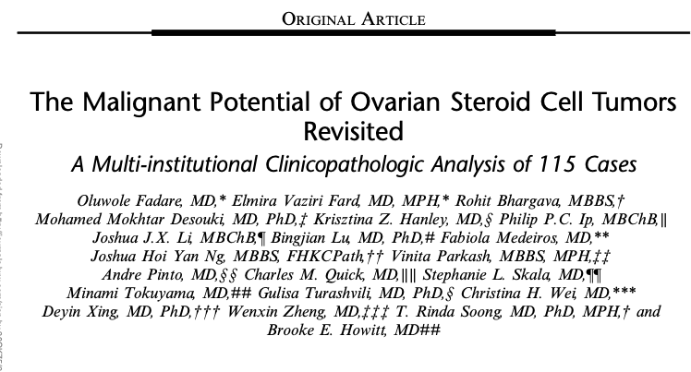
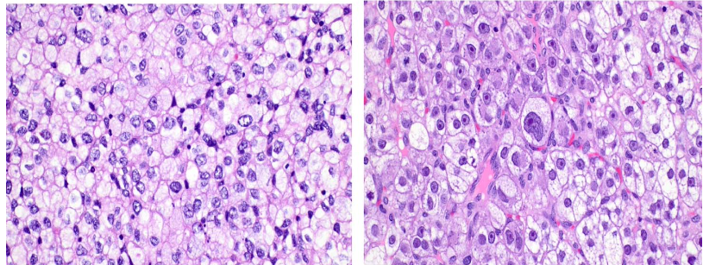
<10% of SCTs are clinically malignant
The actual largest cohort multi-institutional study to date (17 institutions)
The median patient age was 55 years-old (9 - 84)
Androgen levels were elevated in 84.2%

Slide 38
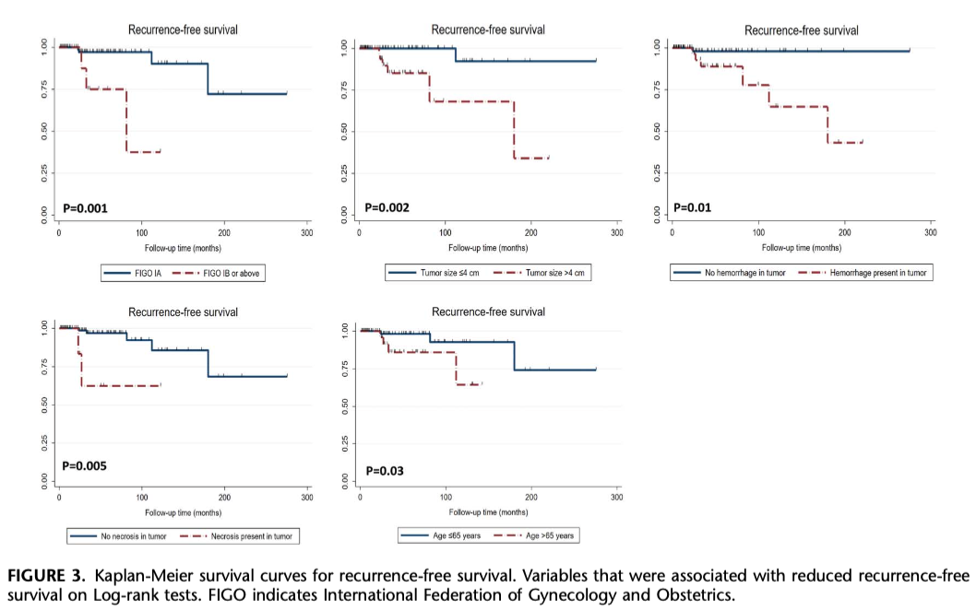
Fadare O, et al.
Am J Surg Pathol. 2024;48(5):570-580

Slide 39
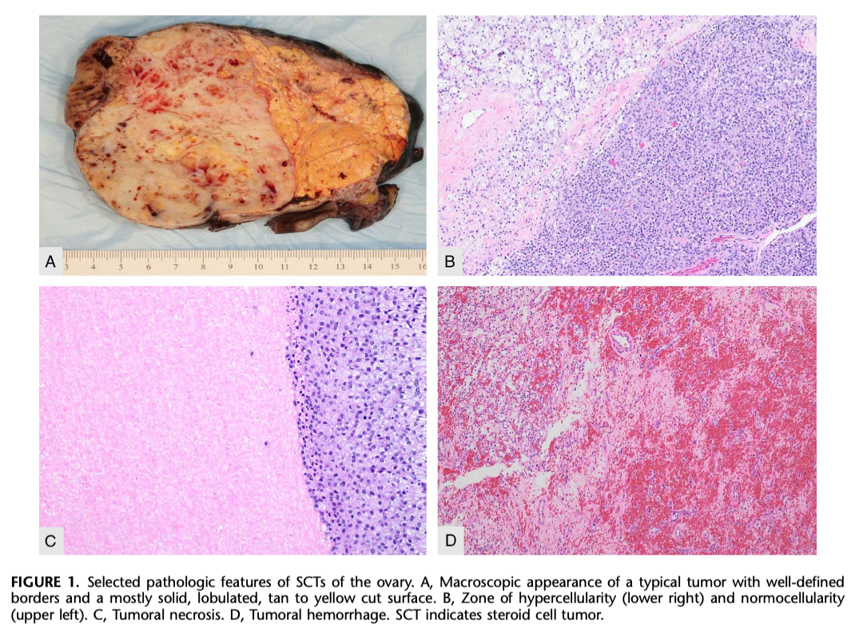
Fadare O, et al.
Am J Surg Pathol. 2024;48(5):570-580

Slide 40
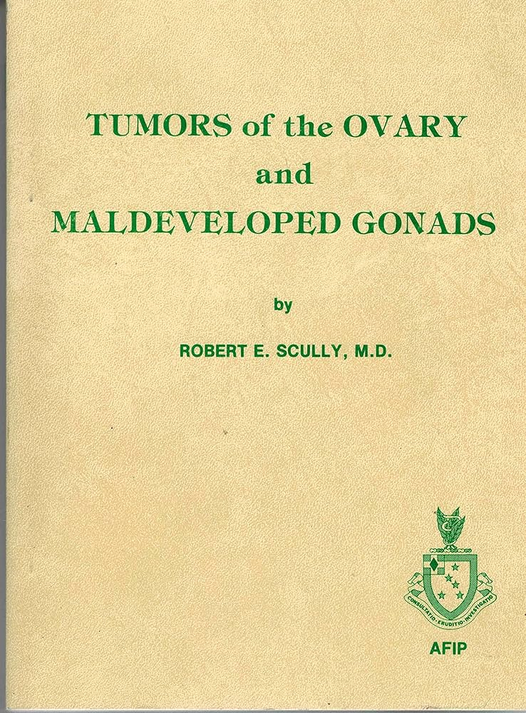
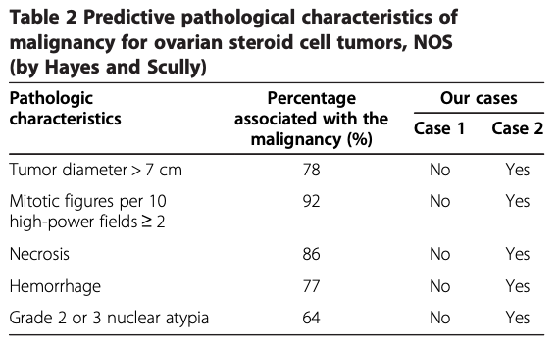
SCT – Historical Context
The term SCT was first proposed by Dr Robert Scully in 1979
Various names were used, such as ovoblastoma and lipoid/lipid cell tumor
In the 4th edition of WHO Female Tumors SCT became the preferred diagnostic term
The seminal series of 63 cases by Hayes and Scully (1987) was the largest study to date
By Hayes & Scully
Jiang W, et al. Benign and malignant ovarian steroid cell tumors, not otherwise specified: case studies, comparison, and review of the literature. Journal of Ovarian Research. 2013, 6:53

Slide 41
SCT – Molecular features
Greater global genomic instability, copy number gains in oncogenes, and occasional BAP1 mutation
Heterogeneous profile of genetic mutations: FH, TP53, CTNNB1, CASP10, HIF1A, SRC, FOXO4, HOXA13, LHCGR, VHL, IDH2, SDHB, and BRCA2
Enrichment of hypoxia-associated gene mutation (HIF1A, VHL, SDHB, SRC, IDH2, and FOXO4)
Mendoza RP, et al. Am J Surg Pathol. 2023 Dec 1;47(12):1398-1408
Wei CH, Fadare O. Front Oncol. 2024 Jan 30;14:1331903

Slide 42
SCT - Summary
Ovarian tumor consisting entirely of cells with steroid-secreting morphology
Cytoplasm range from eosinophilic (lipid-poor) to pale and vacuolated (lipid-rich)
Might present nuclear atypia, necrosis and increased mitotic count
Stains for sex cord markers and Melan-A and might present lipochrome pigment
Prediction of malignancy is difficult, but in the largest series (115 cases), age > 65yo, size >4cm, stage other than FIGO IA, tumor necrosis and hemorrhage were relevant features*
Recurrences may occur many years after primary surgical resection
*Fadare O, et al. Am J Surg Pathol. 2024;48(5):570-580

Slide 43
Acknowledgements
Dr. Fabiola Medeiros, Dr. Louise de Brot and Dr. Leonardo Lordello
Gynecopath group at Rede D’Or São Luiz
Gynecopath group at ICESP – Instituto do Câncer
Dr. Fernando Soares and Dr. Isabela Werneck
Dr. Venâncio Avancini and Dr. Evandro Sobroza de Mello

Slide 44
References
Fadare O, et al. The Malignant Potential of Ovarian Steroid Cell Tumors Revisited: A Multi-institutional Clinicopathologic Analysis of 115 Cases. Am J Surg Pathol. 2024;48(5):570-580
Edmund LN, et al. Cytologic features of sex cord-stromal tumors in women. Cytopathol. 130(1):55-71. 2022.
FOXL2 Mutation Analysis of Ovarian Sex Cord-Stromal Tumors: Genotype-Phenotype Correlation With Diagnostic Considerations. Buza N, et al. Int J Gynecol Pathol. 37(4):305-315. 2018.
Sertoli–Leydig cell tumor of the ovary: Analysis of a single institution database and review of the literature. Durmus Y, et al. J Obstet Gynaecol Res, 45(7):1311-1318. 2019.
Fadare O, et al. Ovarian steroid cell tumors: what do we know so far? Front Oncol. 2024 Jan 30;14:1331903.
Sbitti Y, et al. Diagnostic challenge for ovarian malignant melanoma in premenopausal women: primary or metastatic? World J Surg Oncol. 2011 Jun 17;9:65.
Mendoza RP, et al. Clinicopathologic Analysis and Molecular Profiling of Ovarian Steroid Cell Tumors. Am J Surg Pathol. 2023 Dec 1;47(12):1398-1408.
WHO Classification of Tumours Editorial Board. Female genital tumours Lyon (France): International Agency for Research on Cancer; 2020
Jiang W, et al. Benign and malignant ovarian steroid cell tumors, not otherwise specified: case studies, comparison, and review of the literature. Journal of Ovarian Research. 2013, 6:53

Slide 45
Thank You!
rafael.paschoalini@hc.fm.usp.br

